Slide 1
Pemrograman Berbasis Obyek
PL1AB

Slide 2
Abstract Class
A class that are usually so general, so that there is really no intention to create objects from them.
It contains common attributes & methods for reuse purpose

Slide 3
Abstract Class
It cannot be instantiated.
It’s meaningful in a superclass form, so it must be extended by the subclasses

Slide 4
Abstract Class
For example :
- Mammal
Shape
Electronic device
What else?

Slide 5
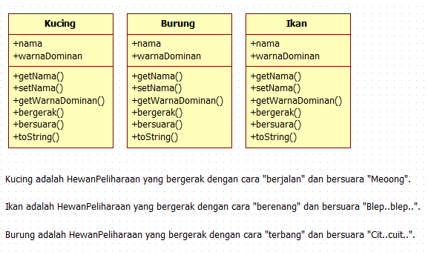

Slide 6
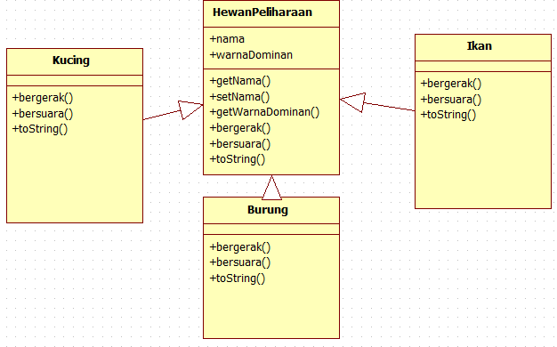

Slide 7
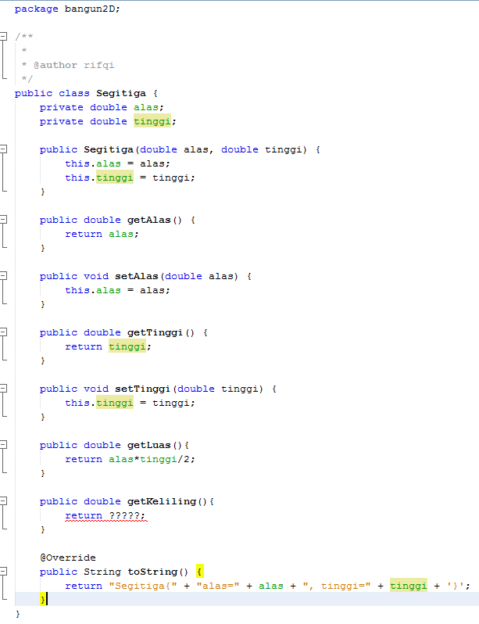
Segitiga
Apa fungsi untuk menghitung Keliling?
sama sisi
3 x sisiMiring
Siku-siku
Alas + tinggi + sisiMiring
Sama kaki
Alas + 2*sisiMiring

Slide 8
Abstract Class
Abstract class must contain an abstract method ?
Abstract method means the method which has a declaration but has no implementation.
A class which extends an abstract class is called a concrete class
All subclass objects must perform an operation.

Slide 9
Abstract Class
You can also use abstract methods when :
All subclass objects must perform an operation, but the superclass can’t provide a default implementation.

Slide 10
Kelas Segitiga
Karena getKeliling() pada class Segitiga pasti ada tapi belum dapat didefinisan (Tergantung pada Jenis Segitiganya), maka method getKeliling() di-set sebagai abstract.
Dikarenakan ada method abstract, maka class Segitiga juga harus abstract.

Slide 11
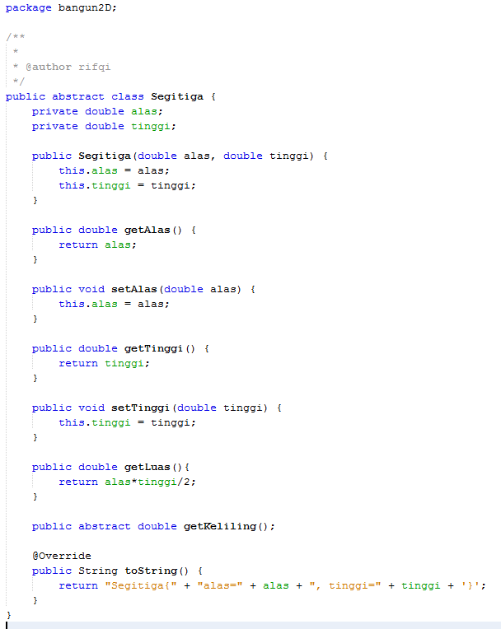
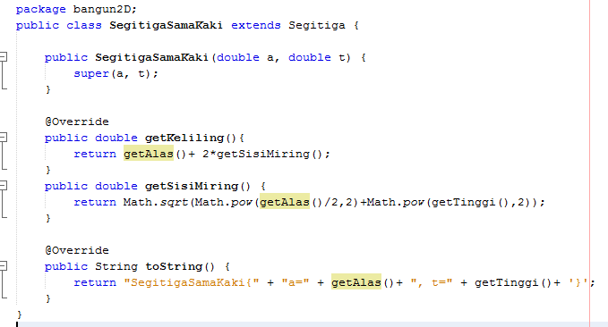
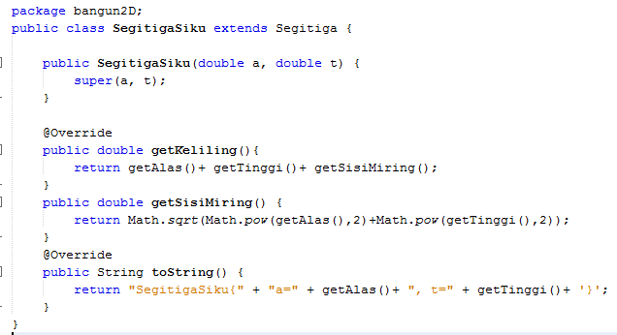
Kelas Segitiga

Slide 12
Abstract Class
You can also use abstract methods when :
All subclass objects must perform an operation, but the superclass can’t provide a default implementation.

Slide 13
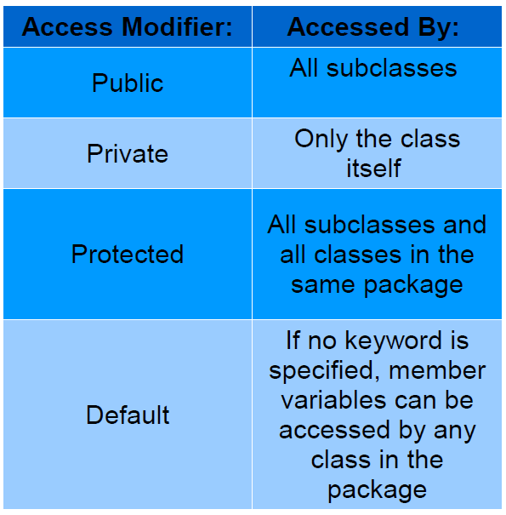
Subclass
Jika ada class yang meng-extends suatu abstract class, maka class tersebut harus meng-override method abstract dari superclassnya.
Aturan override
Nama harus sama
Parameter harus sama
(jumlah dan urutan tipe data)
Return type harus sama
AM / AS :
sama atau naik/lebih luas
Sama -> ok
Naik -> ok
Turun -> nggak ok

Slide 14
Review (1)
abstract class Vehicle {
abstract String getVIN();
}
Is it correct?

Slide 15
Review (2)
Can an abstract class contain fields?
Suppose, in a class, I have more than ten methods, and out of those only one is an abstract method. Is it considered as an abstract class?
Can you create an object from an abstract class?
It appears that an abstract class has virtually no use if it is not extended. Is this correct?

Slide 16
Interface
An interface defines a behavior. It resembles something like a template for a class, as it specifies what a class must do, but not how to do it.
Interfaces contain headings for public methods without implementations.
The subclass need to follow the behaviour in interface.
When you use an interface, you may find many similarities with an abstract class.

Slide 17
jenis khusus dari blok yang hanya berisi method signature(atau constant).
Interface mendefinisikan sebuah(signature) dari sebuah kumpulan method tanpa tubuh.
Interface mendefinisikan sebuah cara standar dan umum dalam menetapkan sifat-sifat dari class-class.
Tidak memperhatikan lokasinya dalam hirarki class
Catatan:
interface juga menunjukkan polimorfisme,
program dapat memanggil method interface dengan dengan menjalankan konsep Virtual Method Invocation

Slide 18
Interface
jenis khusus dari blok yang hanya berisi method signature(atau constant).
Interface mendefinisikan sebuah(signature) dari sebuah kumpulan method tanpa tubuh.
Interface mendefinisikan sebuah cara standar dan umum dalam menetapkan sifat-sifat dari class-class.
Tidak memperhatikan lokasinya dalam hirarki class
Catatan:
interface juga menunjukkan polimorfisme,
program dapat memanggil method interface dengan dengan menjalankan konsep Virtual Method Invocation

Slide 19
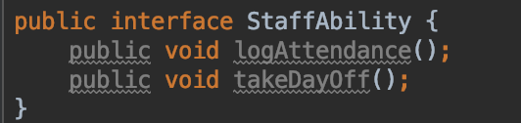
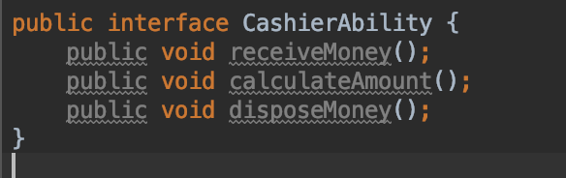
Interface
Implementation of an interface

Slide 20
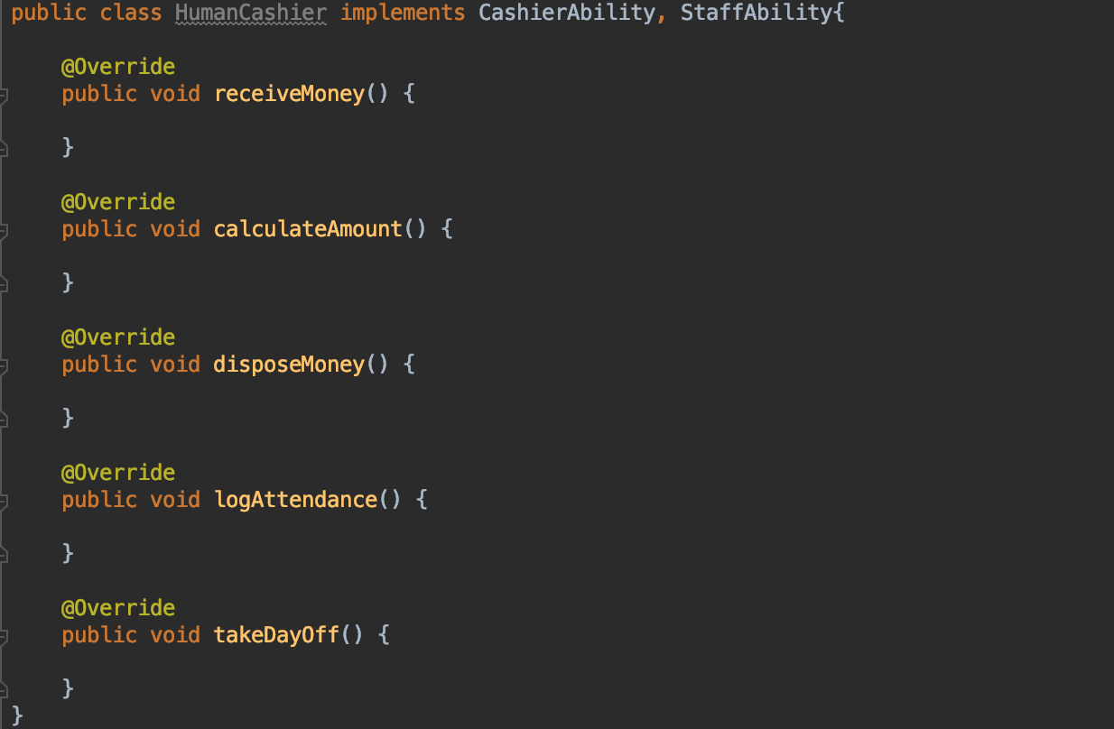
Interface
Implementation of using an interface

Slide 21
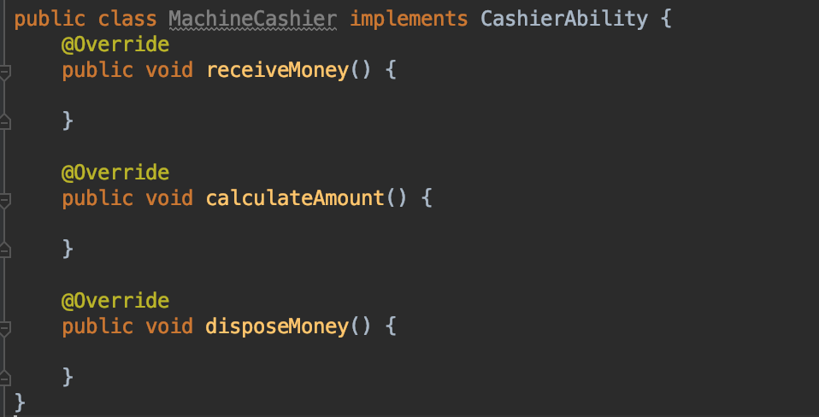
Interface
Implementation of using an interface

Slide 22
Interface
If a class implements an interface, it must implement all methods defined in the interface.
When you use an interface, you may find many similarities with an abstract class.

Slide 23
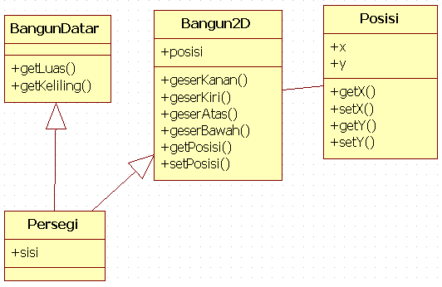

Slide 24
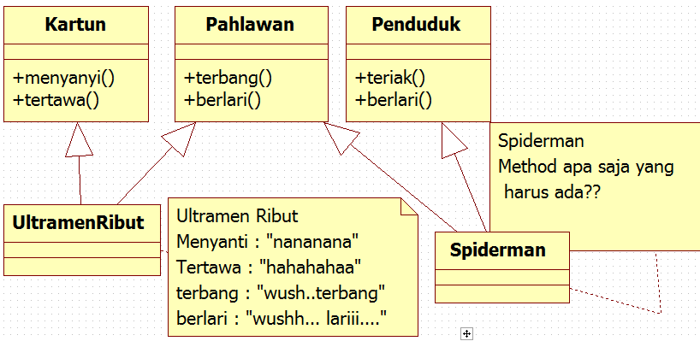

Slide 25
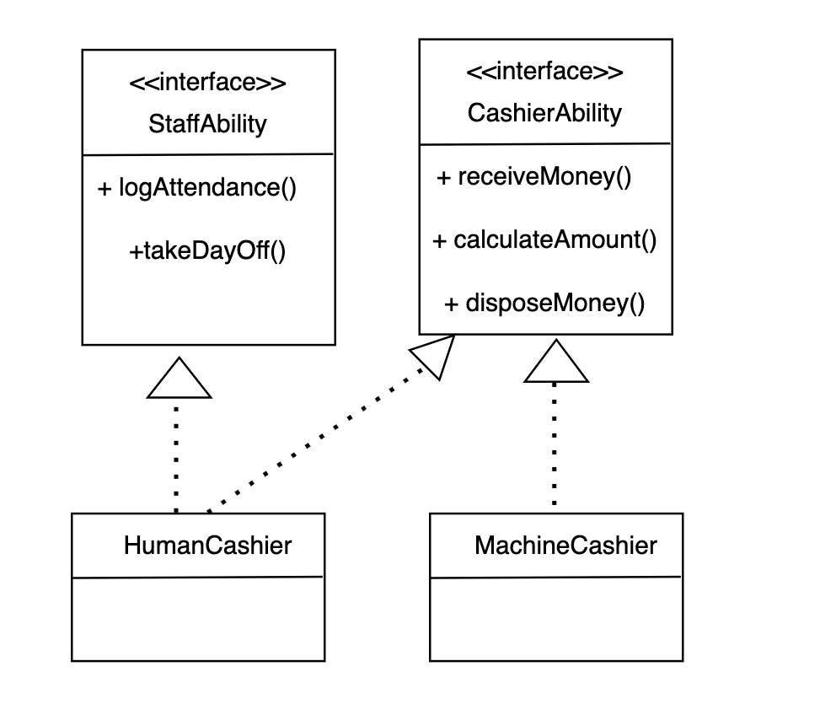
Interface
UML

Slide 26
Interface as a Callback (optional)

Slide 27



Interface as a callback (Sample Case)
It is used to do something after make an asynchronous process
Bro, give me my profile details.
I’ll do something else first, and let me know when the data is ready
User Service
Sure!
I’ll make an API call.
Will keep you updated!
Profile Controller

Slide 28
Interface as a callback (Sample Case)
1. Profile Controller makes a request to retrieve user data
2. User Service makes an API call (talk to the server)
Due to a network call, this process requires some time (Ioading process)
Because it’s async process, profile Controller could do something else while waiting the data
3. Then, after the User Service receives the data, what will be happening?

Slide 29
Interface as a callback (Sample Case)
User Service should tell the Profile Controller, so the Profile Controller could process the data.
But how ?????

Slide 30
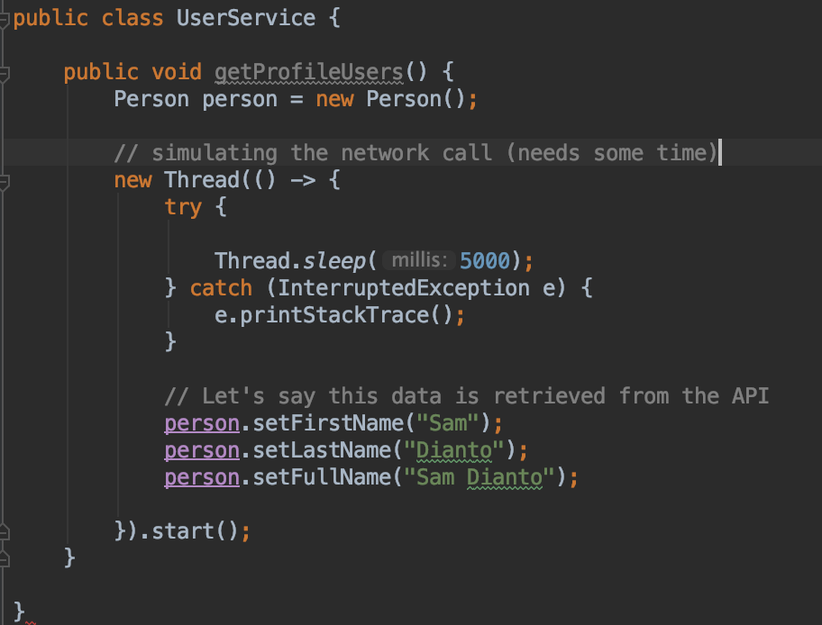
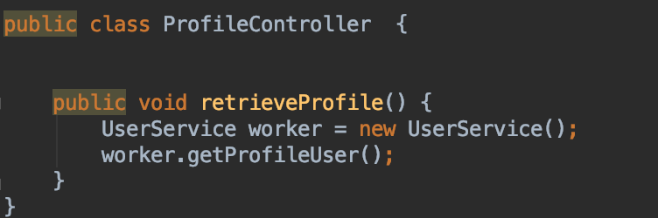
Interface as a callback (Sample Case)
You’ll probably need do this first
What’s next?

Slide 31
Interface as a callback
Imp
Bro, give me my profile detail.
I’ll do something else first, and let me know when you finish.
Homescreen page
Profile Page

Slide 32
Interface vs Abstract class
Interface is used to share common behaviour
Abstract can share common codes : data members & body methods (non abstract methods)
A class at most extend 1 abstract class
A class can implement multiple interfaces

Slide 33
Interface vs Abstract class
Can we implement Animal as an Interface ?

Slide 34
Thank you

